Slide 1
Team Malak
Josh Halat
Lucas Radke
Jordan Shostak Kaitlin Wheeler

Slide 2
Sprint Goals
Implement registration and login functionality
Create view templates
Create patient overview page
Create a landing page for new users

Slide 3
Sprint Accomplishments
Created a user-friendly landing page
Created a patient summary banner
Styled patient overview page and populated it with an example patient from the database
Implemented client-side input validation
Implemented user login and registration functionality

Slide 4
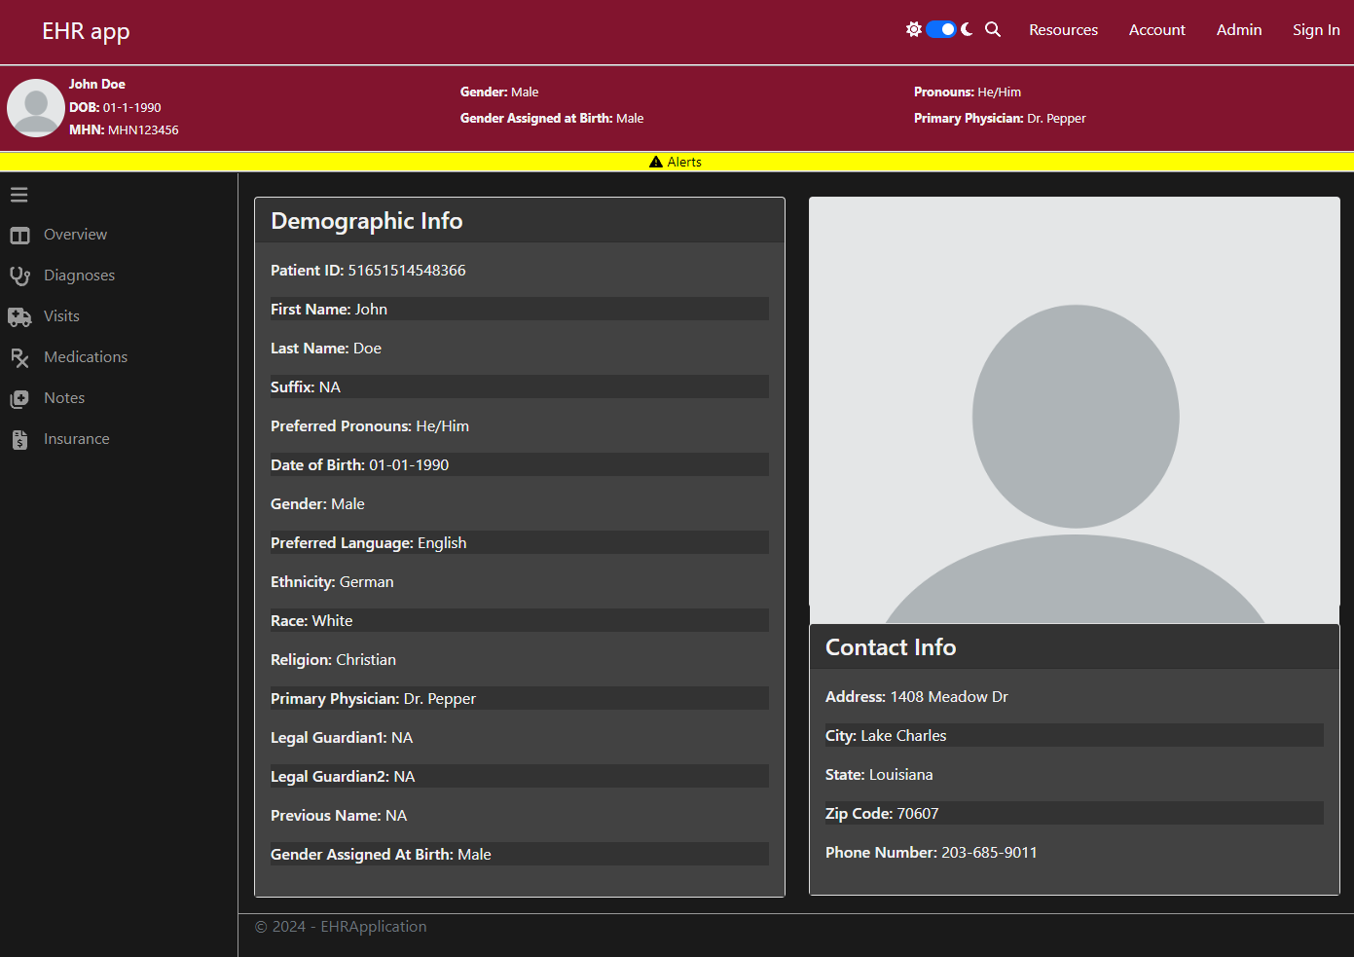
Live Demo

Slide 5
Review
Designed and created:
Landing page
Registration page
Patient overview
Patient banner
Resource page
Implemented user login and registration functionality
Created templates for consistency across views

Slide 6
Questions?

